Slide 1
CHARACTER ARRAYS ‘STRINGS’

Slide 2
Strings
Definition:
A string is an array of characters.
Any group of characters (except double quote sign) defined between double quotation marks is a string.
The common operations performed on strings are:
Reading and writing strings
Combining strings together (concatenation)
Comparing strings to another
Extracting a portion of a string ..etc.
Notes:
A new data type , the character string, which is used to represent a sequence of characters regarded as a single data item. In C++ strings of characters are held as an array of characters, one character held in each array element.

Slide 3
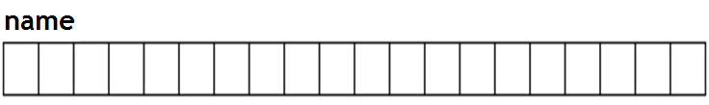
Declaration and initialization
char string_name[size];
The ‘size’ determines the number of characters in the string.
For example, consider the following array:
char name [20];
It is an array that can store up to 19 elements of type char and a null character ‘\0’ .
It can be represented as:
Notes:
Syntax for declaration
char <array/string name> [max. number of characters to be stored +1];
The number of elements that can be stored in a string is always n-1, if the size of the array specified is n. This is because 1 byte is reserved for the NULL character '\0' i.e. backslash zero. A string is always terminated with the NULL character.
Example: char str[80]; In the above example, str can be used to store a string with 79 characters.

Slide 4
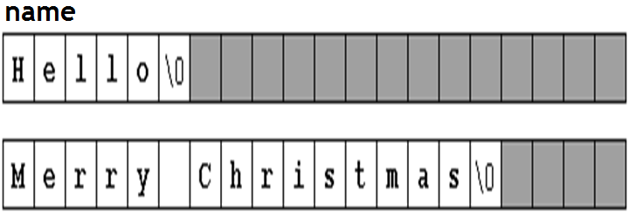
Strings
The character sequences "Hello" and "Merry Christmas" represented in an array name as follows :

Slide 5
String initialization
1. strings are ordinary arrays that follow the same rules of arrays.
For example:
a) char name[20] = “Manipal”;
b) char name[ ] = { 'H', 'e', 'l', 'l', 'o', '\0' };
c) char name[ ] = “How Are You?”;
2. Double quoted (") strings are called literal constants.
3. string literals enclosed between double quotes always have a null character ('\0') automatically appended at the end.
Notes:
Because a character is initialized by including it in single-quotes, when creating an array of characters, to initialize it, you must also include each letter accordingly. A name such as James can be initialized as follows:
char Name[6] = { 'J', 'a', 'm', 'e', 's' };

Slide 6
Example
#include <iostream.h>
#include<string.h>
void main ()
{
char question[] = "Please, enter your first name: ";
char greeting[] = "Hello, ";
char yourname [80];
cout << question;
cin >> yourname;
cout << greeting << yourname << "!";
getch();
}
Notes:
cin
gets()
It can be used to take input of a value of any data type.
It can be used to take input of a string.
It takes the white space i.e. a blank, a tab, or a new line character as a string terminator.
It does not take the white space i.e. a blank, a tab, or a new line character, as a string terminator.
It requires header file iostream.h
It requires the header file stdio.h
Example: char S[80]; cout<<"Enter a string:”; cin>>S;
Example: char S[80]; cout<<"Enter a string:"; gets(S);

Slide 7
Reading Embedded Blanks
To read text containing blanks we use function,
cin.get(array_name, size) ;
The first argument to cin.get() is the array name where
the string being input will be placed.
The second argument specifies the maximum size of the
array, thus automatically avoiding buffer overrun.
Also we use function gets() to read everything (including space). that we enter from the key board until the ENTER key is pressed (including space).
gets(string) ;
we can also use function puts() to display a string.
puts(string) ;
Notes:
Reading strings with/without embedded blanks
To read a string without blanks cin can be used cin>>str; To read a string with blanks cin.getline() or gets() can be used. cin.getline(str,80); -Or- gets(str);

Slide 8
Library functions: String Handling functions (built-in)
These functions are part of string.h header file.
strlen ()
gives the length of the string. E.g. strlen(string)
strcpy ()
copies one string to other. E.g. strcpy(Dstr1,Sstr2)
strcmp ()
compares the two strings. E.g. strcmp(str1,str2)
strcat ()
Concatinate the two strings. E.g. strcat(str1,str2)

Slide 9
Example
#include <iostream>
#include<string.h>
#include<stdio.h>
using namespace std;
int main()
{
char str[80]; //string variable str
cout <<"\n Enter a string: ";
cin.get(str, 80); //or use gets(str)
cout << "You entered:" << str << "\n";
return 0;
}

Slide 10
Count the number of characters in a string
void main()
{
char str[80];
int i=0,count=0;
cout<<"enter a sentence \n“;
gets(str);
puts(str);
while(str[i]!='\0')
{
count++;
i++;
}
cout<<"\n no of characters = "<<count;
}

Slide 11
Count the number of words in a sentence
void main()
{
char str[80];
int i=0,count=1;
cout<<"enter sentence \n";
gets(str)
puts(str);
while(str[i]!='\0')
{
if ( ( str[i] ==' ‘ ) && ( str[i+1]!=' ‘ ) )
count++;
i++;
}
cout<<"\n no. of words = "<<count;
}

Slide 12
Change all lower case letters into uppercase in a sentence
for(i=0;i<len;i++)
{
// 'a'=97, 'A'=65
if(string[i]>='a' && string[i]<='z)
string[i]=string[i]-32;
else if(string[i]>='A' && string[i]<='Z')
string[i]+=32;
else
{
cout<<i<<"is not an alphabet\n";
getch();
exit();
}
}
puts(string);
void main()
{
char string[30];
int i,len=0;
cout<<"\nEnter the string \n";
gets(string);
//find the length of string
for(i=0;string[i]!='\0';i++)
len++;

Slide 13
Check whether a string is Palindrome or not
void main()
{
char str[30];
int i,n,j,len=0,flag=1;
cout<<"\nEnter the string:";
gets(str);
//find the string length
for(i=0;str[i]!='\0';i++)
len++;
for(i=0;i<len/2;i++)
{
if(str[i]!=str[len-i-1])
{
flag=0;
break;
}
}
if(flag==1)
cout<<"\nIts a Palindrome";
else
cout<<"\nNot a Palindrome";
}

Slide 14
To convert a given string representing a number to an integer.
In the string numbers are stored in character format. So if we deduct character '0' from each element we will get the decimal value:
Character Decimal Value
0 48
1 49
2 50
3 51
4 52
5 53
6 54
7 55
8 56
9 57
character ‘6’ – ‘0’ = 54 – 48 = 6 ( decimal 6 )

Slide 15
To convert a given string representing a number to an integer.
int main()
{
char num[100];
int dec = 0, i, len=0;
cout<<"Enter a number: \n";
gets(num);
//find the string length
for(i=0;num[i]!='\0';i++)
len++;
for(i=0; i<len; i++)
dec = dec * 10 + ( num[i] - '0' );
cout<< "The number + 1 is:" <<dec+1 ;
}

Slide 16
Finding Substring in Main String
Main string: cc aa bb aa aa
Sub-String : aa
Enter main string:- cc aa bb aa aa
Enter sub-string : aa
Substring is present 3 times at positions 4 10 13

Slide 17
Finding Substring in Main String
int main()
{
char str1[80],str2[80];
int i,j,len=0;
cout<<"Enter the main string :\n";
gets(str1);
cout<<"Enter sub string :\n";
gets(str2);
//finding length of substring
for(i=0;str2[i]!='\0'; i++)
len++;

Slide 18
Finding Substring in Main String
for(i=0,j=0; str1[i]!='\0‘ && str2[j]!='\0'; i++)
if(str1[i]==str2[j])
j++;
else
j=0;
if(j==len)
cout<<"Substring\t"<<str2<< "\tfound at position "<<i-j+1;
else
cout<<"Substring not found";
}

